Slide 1
Convex Hull
Prakarsh Jain Prateek Mittal Prakash Nidhi Verma
(2016184) (2016189 ) (2016185)

Slide 2
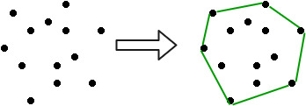
Definition
Smallest Convex Polygon containing all the given points

Slide 3
Implementation of Hand Detection based Techniques for Human Computer Interaction
MOTIVE
Advancement in the Human-Computer interactions on traditional systems.
To make the interaction with machine efficiently.

Slide 4
Limitations
Result might change for different intensity of light.
Can not distinguish between the different orientation of hand.
Distance dependence. Might get faulty results.
Faulty result when skin and background color have marginal differences.

Slide 5
Research Paper Implementation
1. Hand Segmentation
Hand Segmentation deals with separating user’s hand from the background. Otsu’s Thresholding is used for segmenting the hand from background. It convert RGB image to binary image

Slide 6
2. Hand Detection
Contours are straight lines or curves describing the intersection of one or more horizontal planes with a real or hypothetical surface with.
The contour is drawn around the white blob of the hand that is found out by thresholding the input image.

Slide 7
3 Convex Hull & Convexity Defects
The convex hull of a set of points in the Euclidean space is the smallest convex set that contains all the set of given points.
Convex hull is drawn around the contour of the hand, such that all contour points are within the convex hull. This makes an envelope around the hand contour.
A defect is present wherever the contour of the object is away from the convex hull drawn around the same contour.

Slide 8
4.Input Extraction
Convexity Defects are used to extract the count of images .
Many defects are seen on hand due to hand position and orientation. But some defects have greator depth than others.
Hence important defects can be separate out from non important ones.

Slide 9
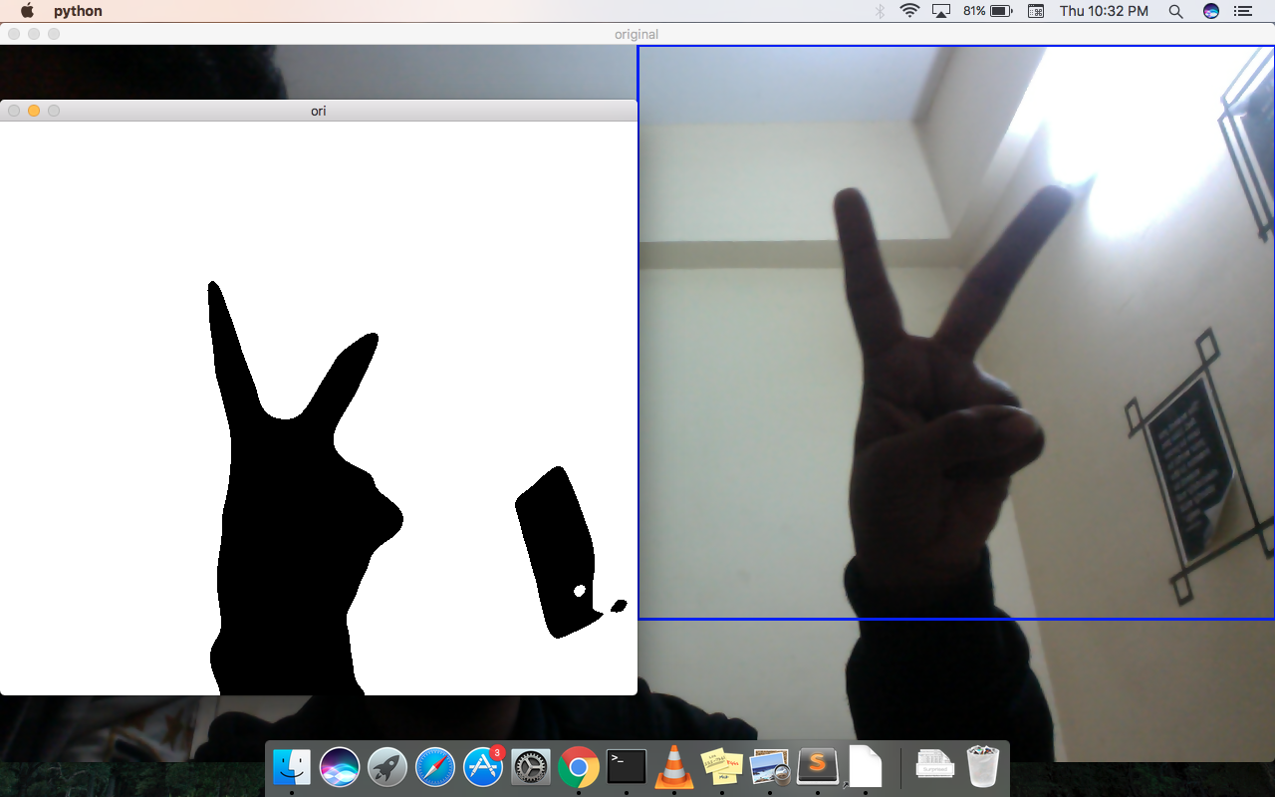
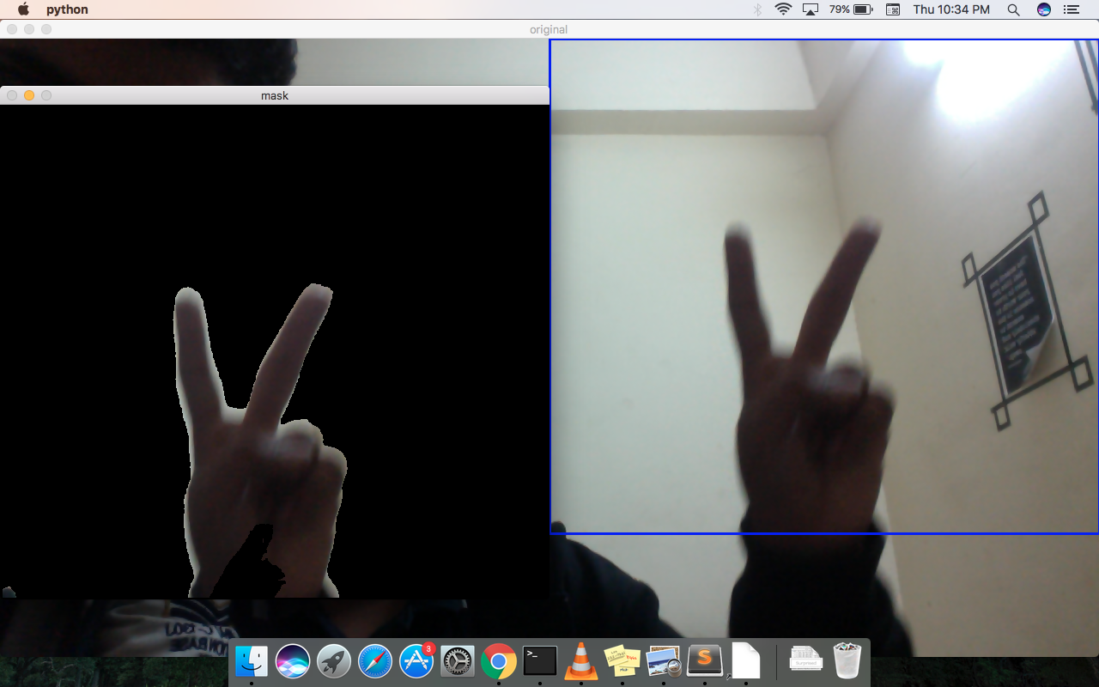
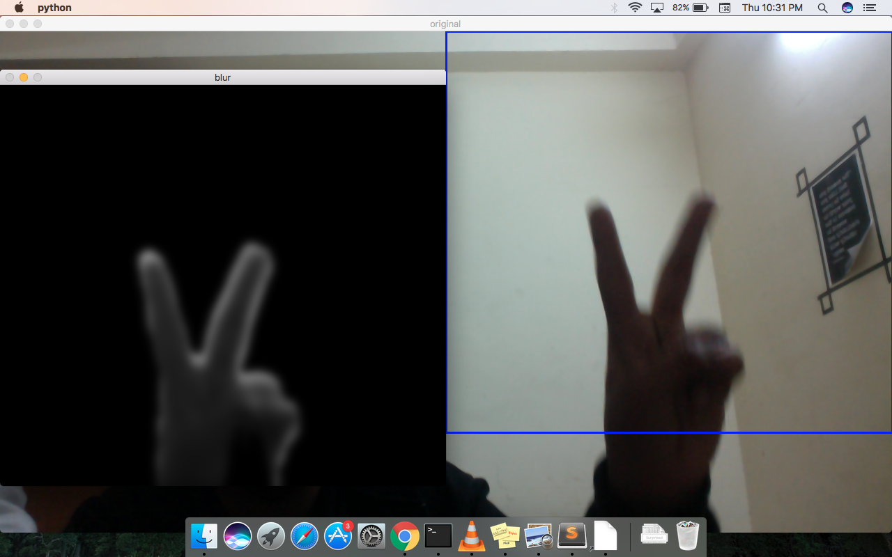
Our Results

Slide 10
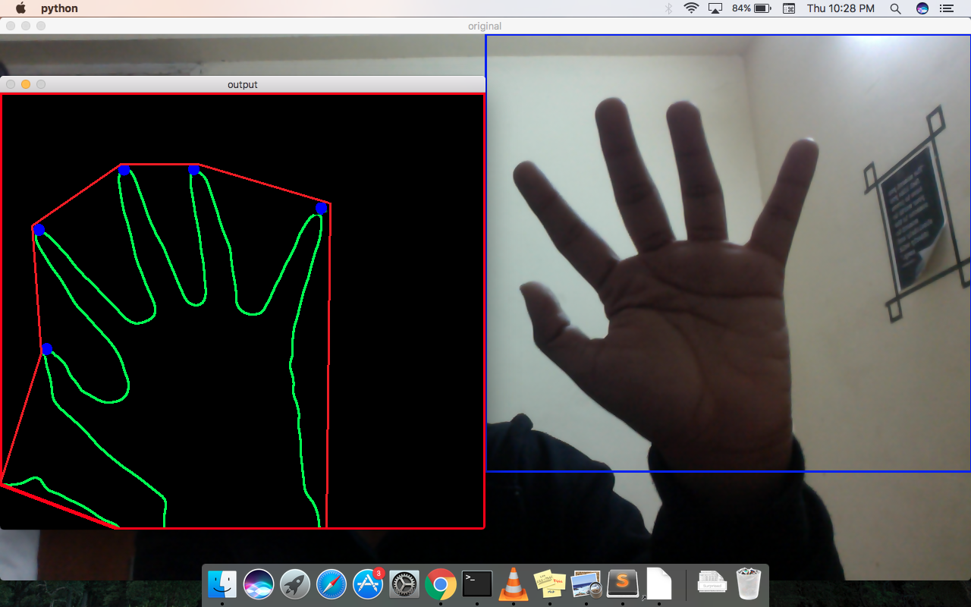
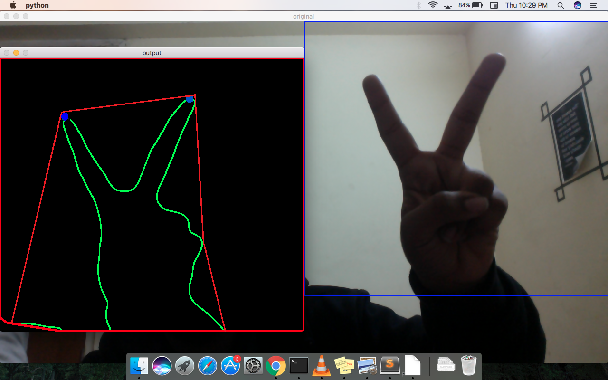

Slide 11
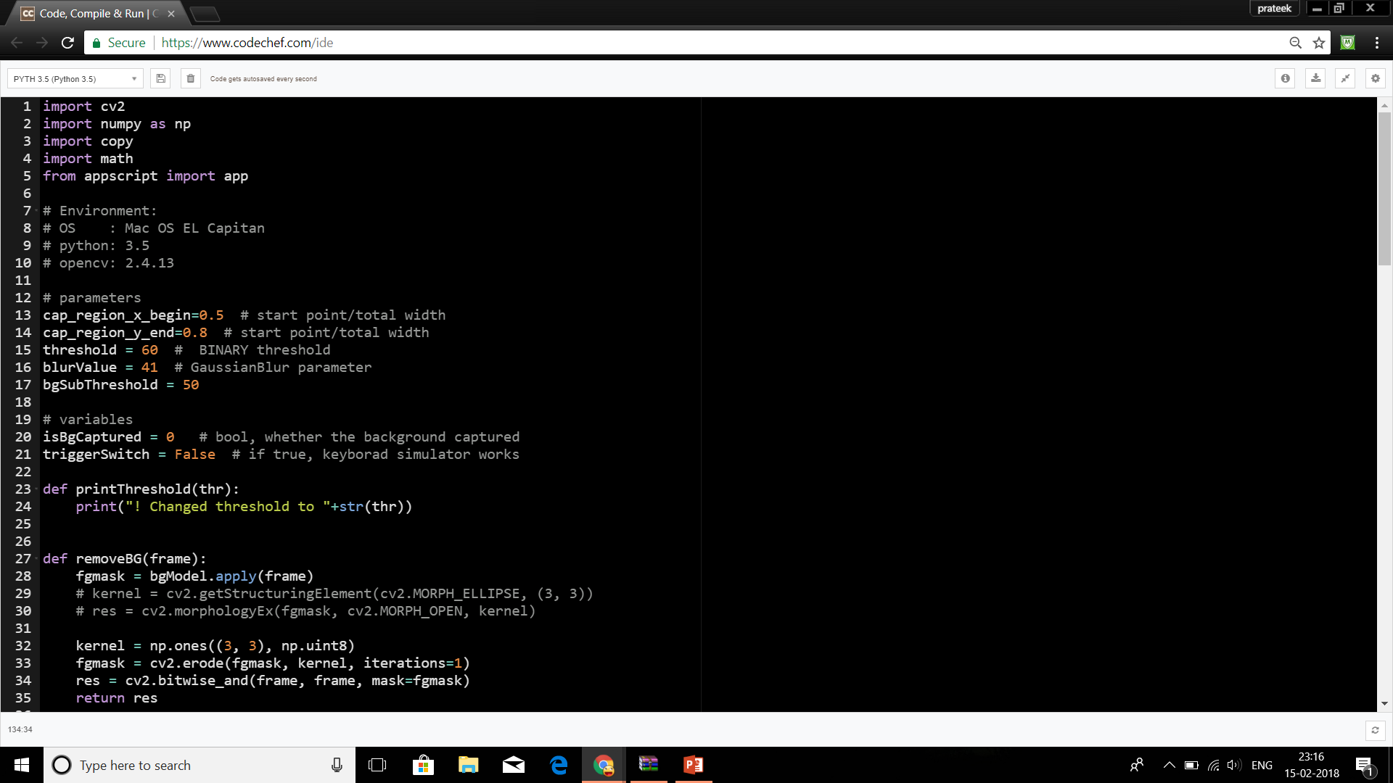
Code Implementation

Slide 12
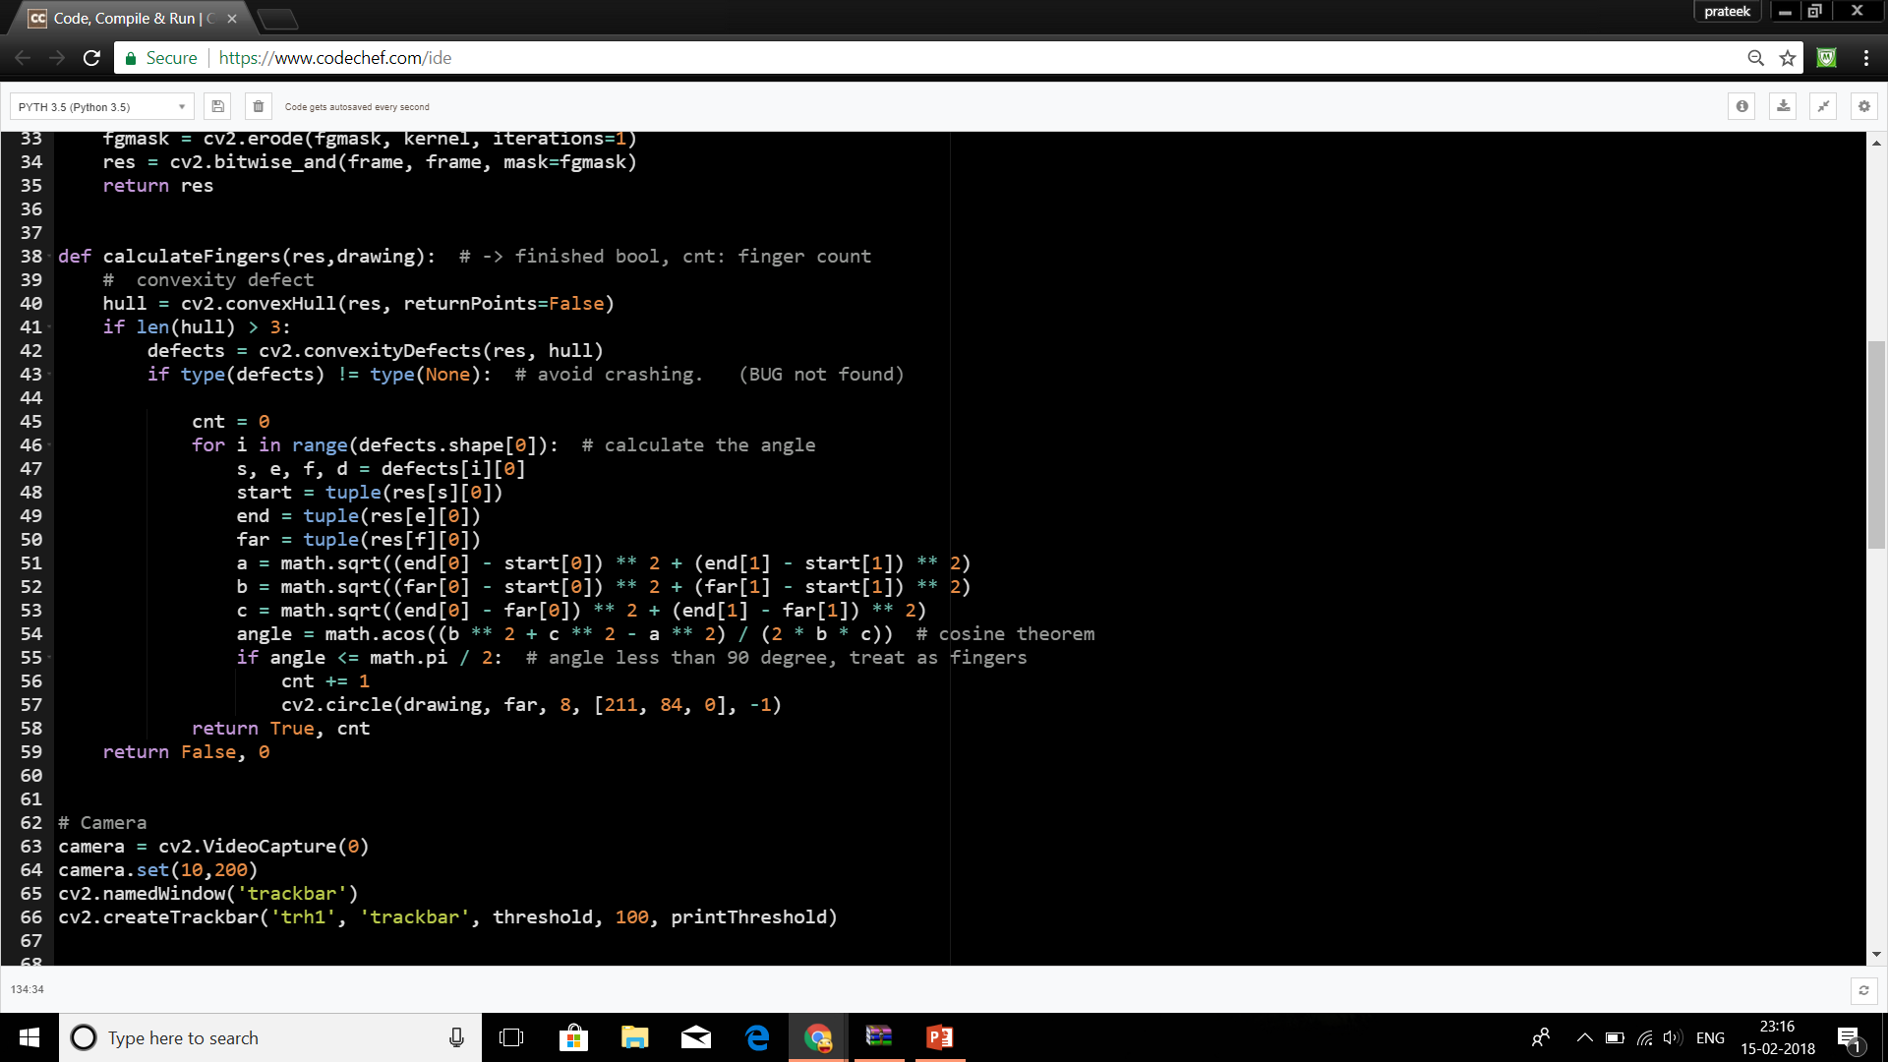

Slide 13
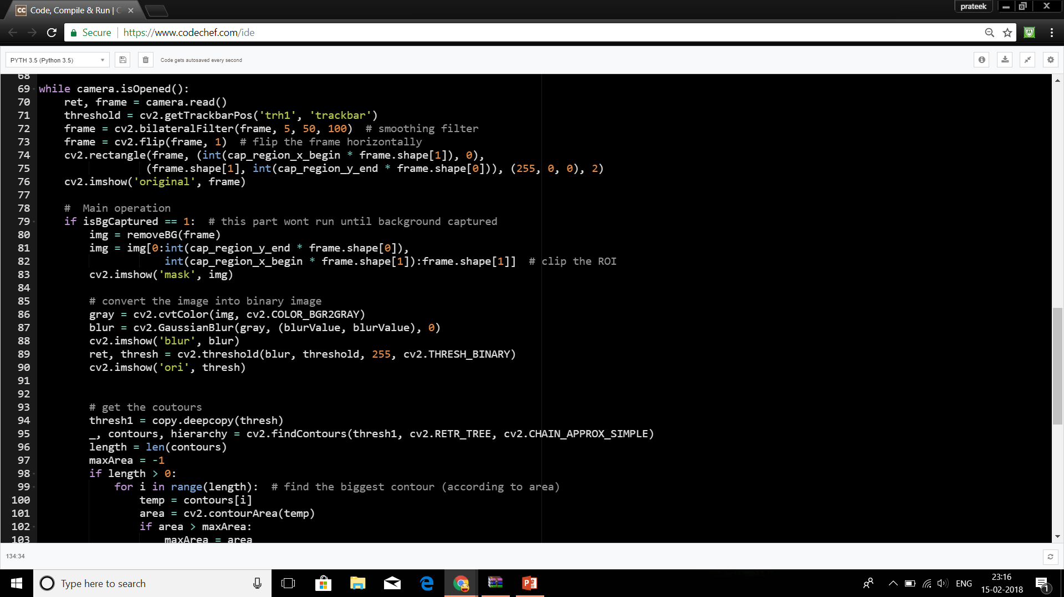

Slide 14
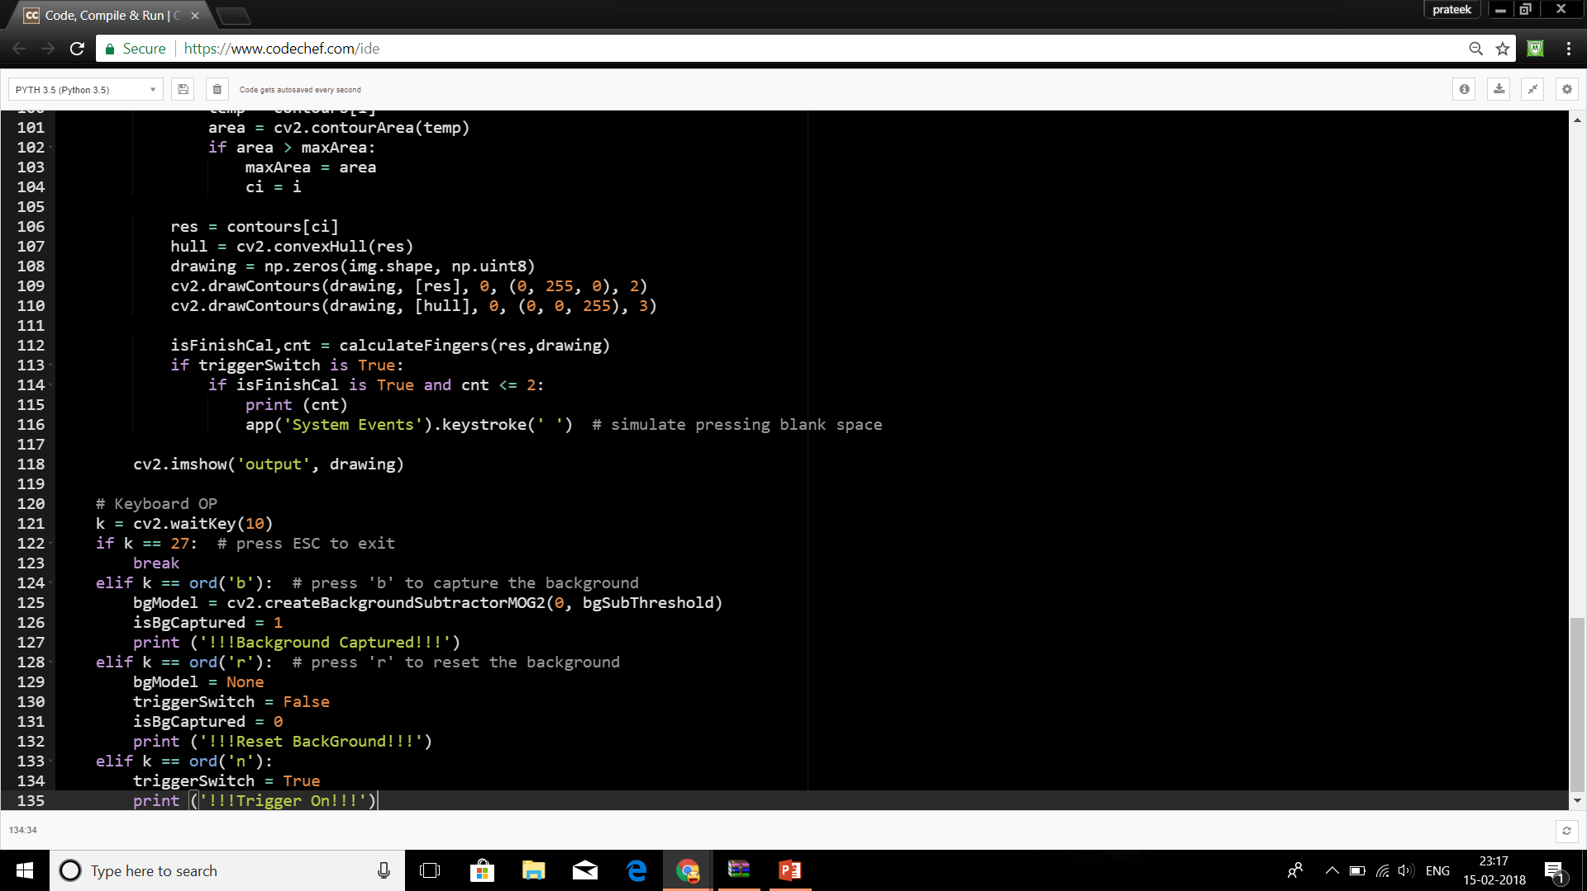

Slide 15
Application of Research Paper
Gesture Controlled Robot using Image Processing
Pick and Place Robot

Slide 16
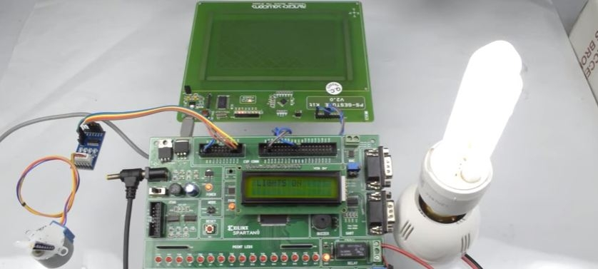
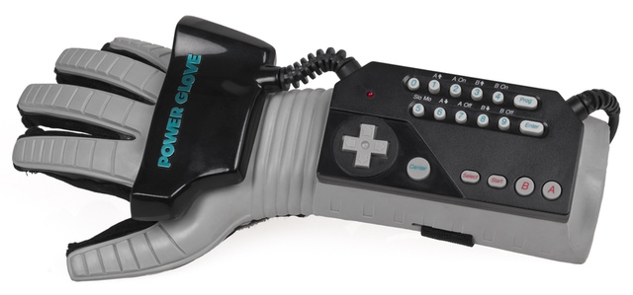
Home Automation
Gaming console

Slide 17
References
www.google.com
www.openCV.org
https://www.lzane.com/fingers-detection-using-opencv-and-python/
www.sciencedirect.com

